Slide 1
Components Part 2

Slide 2
What You Will Learn
Provide and Inject
Dynamic Components
Code Sharing

Slide 3
Provide and Inject

Slide 4
A Potential Problem - Theory
Provide and Inject
Child A
Grand Child
Great Grand Child
Parent
data
Child B
Notes:
A very typical component setup is that a parent can have multiple child components.
A child component, can have its own child component. . And that child component may also have another child component.
Such scenarios usually happen because of how you design your application, think of it as normalizing database tables.
Now, there’s a chance that you’ll need a data from the great grand child to be passed upwards and to the root parent, and then send it to another child
Is there a way to just directly do that?

Slide 5
A Potential Problem - Concrete Example
Provide and Inject
Item Layout Component
Item Grid Component
Item Component
Item Root Component
Active Item Component
Notes:
Here’s a concrete example. You just wanted to have a topic and topics component. And then you realize you can further breakdown your topics component.
In this case, some components end up having props and emits they don’t even need. We call this pass thru components.

Slide 6
Provide + Inject
Provide and Inject
A pattern you can use to provide data in one place and inject it somewhere else
“parent” components serve as dependency provider for all its children
Notes:
Quoted parent because it is not always the root component. It can be any parent component.

Slide 7
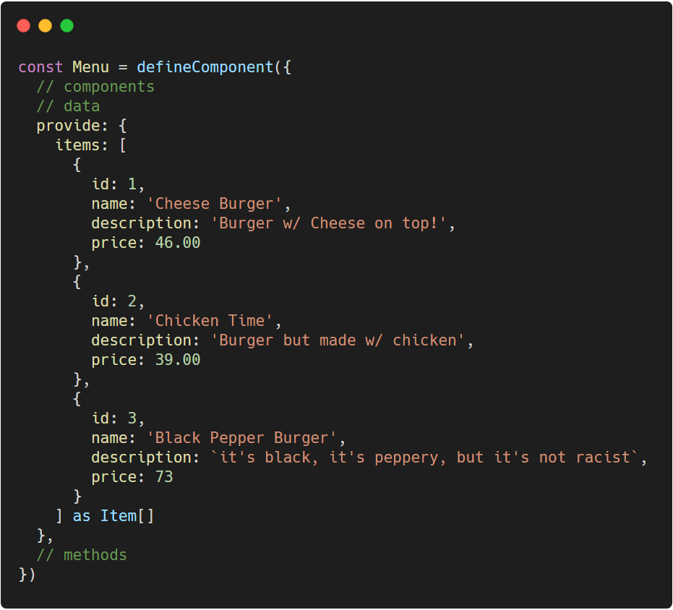
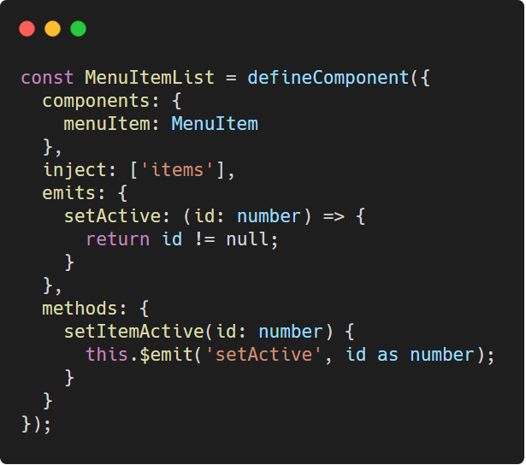
Provide + Inject
Provide and Inject
Menu.vue
MenuListItem.vue
Notes:
Props for KnowledgeBase and KnowledgeGrid components is no longer needed. Hence we can also remove their bindings
Type casting injects is a nuisance right now
Provide: https://carbon.now.sh/?bg=rgba%28255%2C255%2C255%2C1%29&t=vscode&wt=none&l=javascript&ds=false&dsyoff=20px&dsblur=68px&wc=true&wa=true&pv=56px&ph=56px&ln=false&fl=1&fm=Hack&fs=14px&lh=133%25&si=false&es=2x&wm=false&code=const%2520Menu%2520%253D%2520defineComponent%28%257B%250A%2520%2520%252F%252F%2520components%250A%2520%2520%252F%252F%2520data%250A%2520%2520provide%253A%2520%257B%250A%2520%2520%2520%2520items%253A%2520%255B%250A%2520%2520%2520%2520%2520%2520%257B%250A%2520%2520%2520%2520%2520%2520%2520%2520id%253A%25201%252C%250A%2520%2520%2520%2520%2520%2520%2520%2520name%253A%2520%27Cheese%2520Burger%27%252C%250A%2520%2520%2520%2520%2520%2520%2520%2520description%253A%2520%27Burger%2520w%252F%2520Cheese%2520on%2520top%21%27%252C%250A%2520%2520%2520%2520%2520%2520%2520%2520price%253A%252046.00%250A%2520%2520%2520%2520%2520%2520%257D%252C%250A%2520%2520%2520%2520%2520%2520%257B%250A%2520%2520%2520%2520%2520%2520%2520%2520id%253A%25202%252C%250A%2520%2520%2520%2520%2520%2520%2520%2520name%253A%2520%27Chicken%2520Time%27%252C%250A%2520%2520%2520%2520%2520%2520%2520%2520description%253A%2520%27Burger%2520but%2520made%2520w%252F%2520chicken%27%252C%250A%2520%2520%2520%2520%2520%2520%2520%2520price%253A%252039.00%250A%2520%2520%2520%2520%2520%2520%257D%252C%250A%2520%2520%2520%2520%2520%2520%257B%250A%2520%2520%2520%2520%2520%2520%2520%2520id%253A%25203%252C%250A%2520%2520%2520%2520%2520%2520%2520%2520name%253A%2520%27Black%2520Pepper%2520Burger%27%252C%250A%2520%2520%2520%2520%2520%2520%2520%2520description%253A%2520%2560it%27s%2520black%252C%2520it%27s%2520peppery%252C%2520but%2520it%27s%2520not%2520racist%2560%252C%250A%2520%2520%2520%2520%2520%2520%2520%2520price%253A%252073%250A%2520%2520%2520%2520%2520%2520%257D%250A%2520%2520%2520%2520%255D%2520as%2520Item%255B%255D%250A%2520%2520%257D%252C%250A%2520%2520%252F%252F%2520methods%250A%257D%29
Inject: https://carbon.now.sh/?bg=rgba%28255%2C255%2C255%2C1%29&t=vscode&wt=none&l=javascript&ds=false&dsyoff=20px&dsblur=68px&wc=true&wa=true&pv=56px&ph=56px&ln=false&fl=1&fm=Hack&fs=14px&lh=133%25&si=false&es=2x&wm=false&code=const%2520MenuItemList%2520%253D%2520defineComponent%28%257B%250A%2520%2520components%253A%2520%257B%250A%2520%2520%2520%2520menuItem%253A%2520MenuItem%250A%2520%2520%257D%252C%250A%2520%2520inject%253A%2520%255B%27items%27%255D%252C%250A%2520%2520emits%253A%2520%257B%250A%2520%2520%2520%2520setActive%253A%2520%28id%253A%2520number%29%2520%253D%253E%2520%257B%250A%2520%2520%2520%2520%2520%2520return%2520id%2520%21%253D%2520null%253B%250A%2520%2520%2520%2520%257D%250A%2520%2520%257D%252C%250A%2520%2520methods%253A%2520%257B%250A%2520%2520%2520%2520setItemActive%28id%253A%2520number%29%2520%257B%250A%2520%2520%2520%2520%2520%2520this.%2524emit%28%27setActive%27%252C%2520id%2520as%2520number%29%253B%250A%2520%2520%2520%2520%257D%250A%2520%2520%257D%250A%257D%29%253B

Slide 8
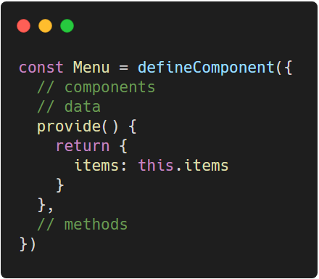
Provide - data
Provide and Inject
We can also provide a value that is already existing from the data option
Provide would then be a function instead
Notes:
Code: https://carbon.now.sh/?bg=rgba%28255%2C255%2C255%2C1%29&t=vscode&wt=none&l=javascript&ds=false&dsyoff=20px&dsblur=68px&wc=true&wa=true&pv=56px&ph=56px&ln=false&fl=1&fm=Hack&fs=14px&lh=133%25&si=false&es=2x&wm=false&code=const%2520Menu%2520%253D%2520defineComponent%28%257B%250A%2520%2520%252F%252F%2520components%250A%2520%2520%252F%252F%2520data%250A%2520%2520provide%28%29%2520%257B%250A%2520%2520%2520%2520return%2520%257B%250A%2520%2520%2520%2520%2520%2520items%253A%2520this.items%250A%2520%2520%2520%2520%257D%250A%2520%2520%257D%252C%250A%2520%2520%252F%252F%2520methods%250A%257D%29

Slide 9
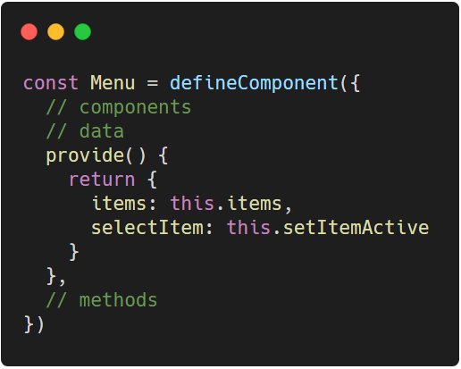
Provide - methods
Provide and Inject
We can also provide methods so that we don’t need to have a traversing emit
Only point to the method when providing
Notes:
You don’t have to execute it when providing. On the injected component, you must execute it.
Code: https://carbon.now.sh/?bg=rgba%28255%2C255%2C255%2C1%29&t=vscode&wt=none&l=javascript&ds=false&dsyoff=20px&dsblur=68px&wc=true&wa=true&pv=56px&ph=56px&ln=false&fl=1&fm=Hack&fs=14px&lh=133%25&si=false&es=2x&wm=false&code=const%2520Menu%2520%253D%2520defineComponent%28%257B%250A%2520%2520%252F%252F%2520components%250A%2520%2520%252F%252F%2520data%250A%2520%2520provide%28%29%2520%257B%250A%2520%2520%2520%2520return%2520%257B%250A%2520%2520%2520%2520%2520%2520items%253A%2520this.items%252C%250A%2520%2520%2520%2520%2520%2520selectItem%253A%2520this.setItemActive%250A%2520%2520%2520%2520%257D%250A%2520%2520%257D%252C%250A%2520%2520%252F%252F%2520methods%250A%257D%29

Slide 10
Dynamic Components

Slide 11
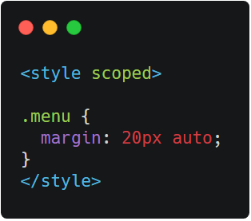
Component Styling
Dynamic Components
You may opt to have your stylings limited to the current component via the scoped attribute
Notes:
By default, styles are global. Vue adds a specific attribute to your component elements on the DOM hence it knows which styles are relevant to the component.
CSS: https://carbon.now.sh/?bg=rgba%28255%2C255%2C255%2C1%29&t=seti&wt=none&l=htmlmixed&ds=false&dsyoff=20px&dsblur=68px&wc=true&wa=true&pv=56px&ph=56px&ln=false&fl=1&fm=Hack&fs=14px&lh=133%25&si=false&es=2x&wm=false&code=%253Cstyle%2520scoped%253E%250A%250A.menu%2520%257B%250A%2520%2520margin%253A%252020px%2520auto%253B%250A%257D%250A%253C%252Fstyle%253E

Slide 12
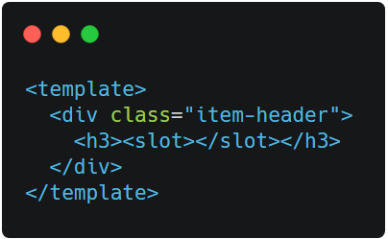
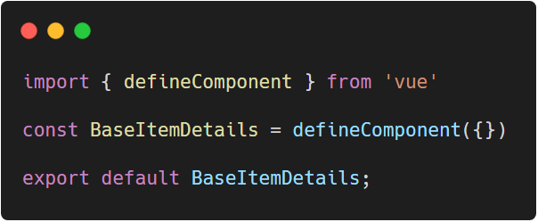
Introducing Slots
Dynamic Components
Slot is a standalone component which has its own styling and is a more flexible way of wrapping components
Notes:
Think of slots as a prop where you pass in content instead of data. Slot components are usually registered globally.
HTML: https://carbon.now.sh/?bg=rgba%28255%2C255%2C255%2C1%29&t=seti&wt=none&l=htmlmixed&ds=false&dsyoff=20px&dsblur=68px&wc=true&wa=true&pv=56px&ph=56px&ln=false&fl=1&fm=Hack&fs=14px&lh=133%25&si=false&es=2x&wm=false&code=%253Ctemplate%253E%250A%2520%2520%253Cdiv%2520class%253D%2522item-header%2522%253E%250A%2520%2520%2520%2520%253Ch3%253E%253Cslot%253E%253C%252Fslot%253E%253C%252Fh3%253E%250A%2520%2520%253C%252Fdiv%253E%250A%253C%252Ftemplate%253E
Code: https://carbon.now.sh/?bg=rgba%28255%2C255%2C255%2C1%29&t=vscode&wt=none&l=javascript&ds=false&dsyoff=20px&dsblur=68px&wc=true&wa=true&pv=56px&ph=56px&ln=false&fl=1&fm=Hack&fs=14px&lh=133%25&si=false&es=2x&wm=false&code=import%2520%257B%2520defineComponent%2520%257D%2520from%2520%27vue%27%250A%250Aconst%2520BaseItemDetails%2520%253D%2520defineComponent%28%257B%257D%29%250A%250Aexport%2520default%2520BaseItemDetails%253B

Slide 13
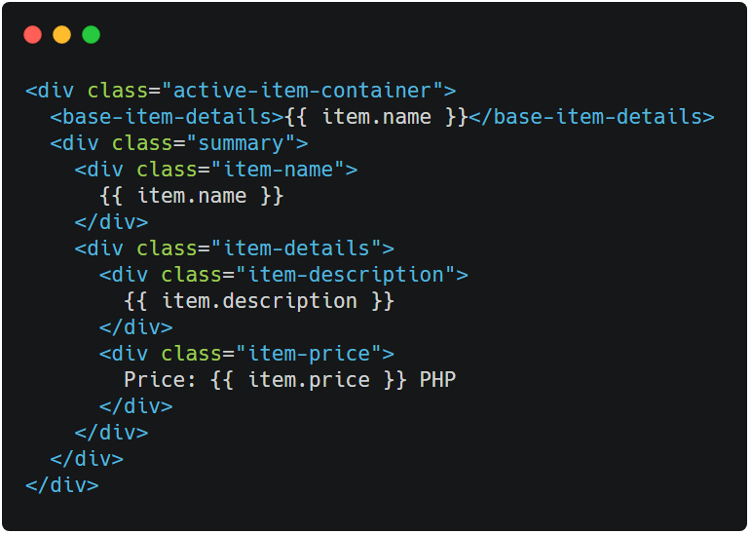
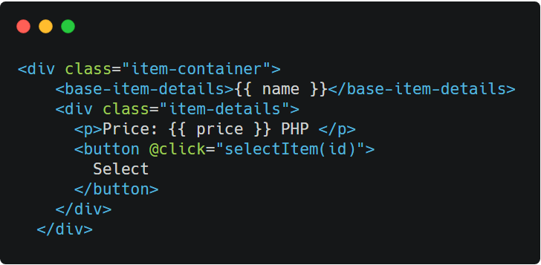
Slot usage
Dynamic Components
ActiveItem.vue
MenuItem.vue
Notes:
We can then remove the unnecessary CSS files
ActiveItem: https://carbon.now.sh/?bg=rgba%28255%2C255%2C255%2C1%29&t=seti&wt=none&l=htmlmixed&ds=false&dsyoff=20px&dsblur=68px&wc=true&wa=true&pv=56px&ph=56px&ln=false&fl=1&fm=Hack&fs=14px&lh=133%25&si=false&es=2x&wm=false&code=%253Cdiv%2520class%253D%2522active-item-container%2522%253E%250A%2520%2520%253Cbase-item-details%253E%257B%257B%2520item.name%2520%257D%257D%253C%252Fbase-item-details%253E%250A%2520%2520%253Cdiv%2520class%253D%2522summary%2522%253E%250A%2520%2520%2520%2520%253Cdiv%2520class%253D%2522item-name%2522%253E%250A%2520%2520%2520%2520%2520%2520%257B%257B%2520item.name%2520%257D%257D%250A%2520%2520%2520%2520%253C%252Fdiv%253E%250A%2520%2520%2520%2520%253Cdiv%2520class%253D%2522item-details%2522%253E%250A%2520%2520%2520%2520%2520%2520%253Cdiv%2520class%253D%2522item-description%2522%253E%250A%2520%2520%2520%2520%2520%2520%2520%2520%257B%257B%2520item.description%2520%257D%257D%250A%2520%2520%2520%2520%2520%2520%253C%252Fdiv%253E%250A%2520%2520%2520%2520%2520%2520%253Cdiv%2520class%253D%2522item-price%2522%253E%250A%2520%2520%2520%2520%2520%2520%2520%2520Price%253A%2520%257B%257B%2520item.price%2520%257D%257D%2520PHP%250A%2520%2520%2520%2520%2520%2520%253C%252Fdiv%253E%250A%2520%2520%2520%2520%253C%252Fdiv%253E%250A%2520%2520%253C%252Fdiv%253E%250A%253C%252Fdiv%253E
MenuItem: https://carbon.now.sh/?bg=rgba%28255%2C255%2C255%2C1%29&t=seti&wt=none&l=htmlmixed&ds=false&dsyoff=20px&dsblur=68px&wc=true&wa=true&pv=56px&ph=56px&ln=false&fl=1&fm=Hack&fs=14px&lh=133%25&si=false&es=2x&wm=false&code=%253Cdiv%2520class%253D%2522item-container%2522%253E%250A%2520%2520%2520%2520%253Cbase-item-details%253E%257B%257B%2520name%2520%257D%257D%253C%252Fbase-item-details%253E%250A%2520%2520%2520%2520%253Cdiv%2520class%253D%2522item-details%2522%253E%250A%2520%2520%2520%2520%2520%2520%253Cp%253EPrice%253A%2520%257B%257B%2520price%2520%257D%257D%2520PHP%2520%253C%252Fp%253E%250A%2520%2520%2520%2520%2520%2520%253Cbutton%2520%2540click%253D%2522selectItem%28id%29%2522%253E%250A%2520%2520%2520%2520%2520%2520%2520%2520Select%250A%2520%2520%2520%2520%2520%2520%253C%252Fbutton%253E%250A%2520%2520%2520%2520%253C%252Fdiv%253E%250A%2520%2520%253C%252Fdiv%253E

Slide 14
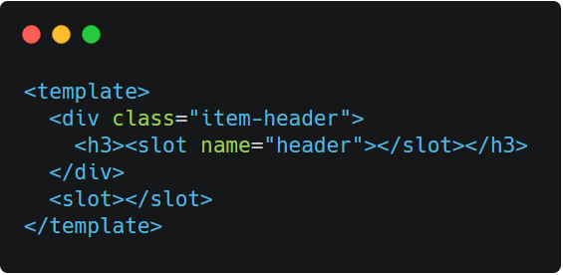
Named Slots
Dynamic Components
For instances where you’ll need multiple slots inside a wrapper component, you can add other slots and give them names
Notes:
For example, we’d like to add a header slot inside our base card component other than just the content. You can only have one un-named slot
HTML: https://carbon.now.sh/?bg=rgba%28255%2C255%2C255%2C1%29&t=seti&wt=none&l=htmlmixed&ds=false&dsyoff=20px&dsblur=68px&wc=true&wa=true&pv=56px&ph=56px&ln=false&fl=1&fm=Hack&fs=14px&lh=133%25&si=false&es=2x&wm=false&code=%253Ctemplate%253E%250A%2520%2520%253Cdiv%2520class%253D%2522item-header%2522%253E%250A%2520%2520%2520%2520%253Ch3%253E%253Cslot%2520name%253D%2522header%2522%253E%253C%252Fslot%253E%253C%252Fh3%253E%250A%2520%2520%253C%252Fdiv%253E%250A%2520%2520%253Cslot%253E%253C%252Fslot%253E%250A%253C%252Ftemplate%253E

Slide 15
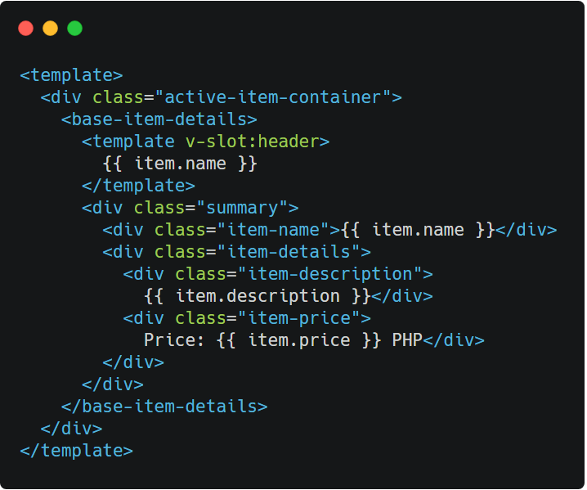
Named slot usage - v-slot directive
Dynamic Components
The content that goes inside the named slot is then wrapped around a template tag w/ a v-slot directive
:name is the name of the slot
Notes:
Do note that scoped stylings inside slot components only affect unique elements inside. It does not in any way affect the component it is wrapping
https://carbon.now.sh/?bg=rgba%28255%2C255%2C255%2C1%29&t=seti&wt=none&l=htmlmixed&ds=false&dsyoff=20px&dsblur=68px&wc=true&wa=true&pv=56px&ph=56px&ln=false&fl=1&fm=Hack&fs=14px&lh=133%25&si=false&es=2x&wm=false&code=%253Ctemplate%253E%250A%2520%2520%253Cdiv%2520class%253D%2522active-item-container%2522%253E%250A%2520%2520%2520%2520%253Cbase-item-details%253E%250A%2520%2520%2520%2520%2520%2520%253Ctemplate%2520v-slot%253Aheader%253E%250A%2520%2520%2520%2520%2520%2520%2520%2520%257B%257B%2520item.name%2520%257D%257D%250A%2520%2520%2520%2520%2520%2520%253C%252Ftemplate%253E%250A%2520%2520%2520%2520%2520%2520%253Cdiv%2520class%253D%2522summary%2522%253E%250A%2520%2520%2520%2520%2520%2520%2520%2520%253Cdiv%2520class%253D%2522item-name%2522%253E%257B%257B%2520item.name%2520%257D%257D%253C%252Fdiv%253E%250A%2520%2520%2520%2520%2520%2520%2520%2520%253Cdiv%2520class%253D%2522item-details%2522%253E%250A%2520%2520%2520%2520%2520%2520%2520%2520%2520%2520%253Cdiv%2520class%253D%2522item-description%2522%253E%250A%2520%2520%2520%2520%2520%2520%2520%2520%2520%2520%2520%2520%257B%257B%2520item.description%2520%257D%257D%253C%252Fdiv%253E%250A%2520%2520%2520%2520%2520%2520%2520%2520%2520%2520%253Cdiv%2520class%253D%2522item-price%2522%253E%250A%2520%2520%2520%2520%2520%2520%2520%2520%2520%2520%2520%2520Price%253A%2520%257B%257B%2520item.price%2520%257D%257D%2520PHP%253C%252Fdiv%253E%250A%2520%2520%2520%2520%2520%2520%2520%2520%253C%252Fdiv%253E%250A%2520%2520%2520%2520%2520%2520%253C%252Fdiv%253E%250A%2520%2520%2520%2520%253C%252Fbase-item-details%253E%250A%2520%2520%253C%252Fdiv%253E%250A%253C%252Ftemplate%253E

Slide 16
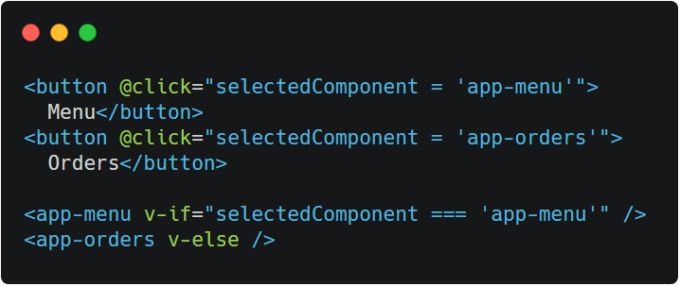
Tabs - a problem
Dynamic Components
Let’s just say for an instance, we have like a page that has tabs on it.
This solution could work!
Notes:
We’d like it such that even if we traverse between those two, data doesn’t keep on reverting back. The problem in this setup is that every time we switch pages, the data reverts back. We can probably use v-show instead.
The problem with v-if and v-show is, the more tabs you add, the more conditions you’ll add as well.
HTML: https://carbon.now.sh/?bg=rgba%28255%2C255%2C255%2C1%29&t=seti&wt=none&l=htmlmixed&ds=false&dsyoff=20px&dsblur=68px&wc=true&wa=true&pv=56px&ph=56px&ln=false&fl=1&fm=Hack&fs=14px&lh=133%25&si=false&es=2x&wm=false&code=%253Cbutton%2520%2540click%253D%2522selectedComponent%2520%253D%2520%27app-menu%27%2522%253E%250A%2520%2520Menu%253C%252Fbutton%253E%250A%253Cbutton%2520%2540click%253D%2522selectedComponent%2520%253D%2520%27app-orders%27%2522%253E%250A%2520%2520Orders%253C%252Fbutton%253E%250A%250A%253Capp-menu%2520v-if%253D%2522selectedComponent%2520%253D%253D%253D%2520%27app-menu%27%2522%2520%252F%253E%250A%253Capp-orders%2520v-else%2520%252F%253E

Slide 17
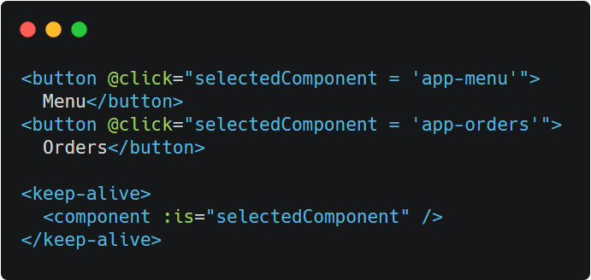
Component directive
Dynamic Components
Tells Vue to render a component based on its name
Shortens the code by a long shot
Notes:
Shortens the code because there is no conditionals you need to add inside the HTML part of the code.
Keep alive works with the dynamic component concept. It tells vue to save the component’s state behind the scenes.
Keep alive is optional, but if removed then the state gets revered every component switch
HTML: https://carbon.now.sh/?bg=rgba%28255%2C255%2C255%2C1%29&t=seti&wt=none&l=htmlmixed&ds=false&dsyoff=20px&dsblur=68px&wc=true&wa=true&pv=56px&ph=56px&ln=false&fl=1&fm=Hack&fs=14px&lh=133%25&si=false&es=2x&wm=false&code=%253Cbutton%2520%2540click%253D%2522selectedComponent%2520%253D%2520%27app-menu%27%2522%253E%250A%2520%2520Menu%253C%252Fbutton%253E%250A%253Cbutton%2520%2540click%253D%2522selectedComponent%2520%253D%2520%27app-orders%27%2522%253E%250A%2520%2520Orders%253C%252Fbutton%253E%250A%250A%253Ckeep-alive%253E%250A%2520%2520%253Ccomponent%2520%253Ais%253D%2522selectedComponent%2522%2520%252F%253E%250A%253C%252Fkeep-alive%253E

Slide 18
Code Sharing

Slide 19
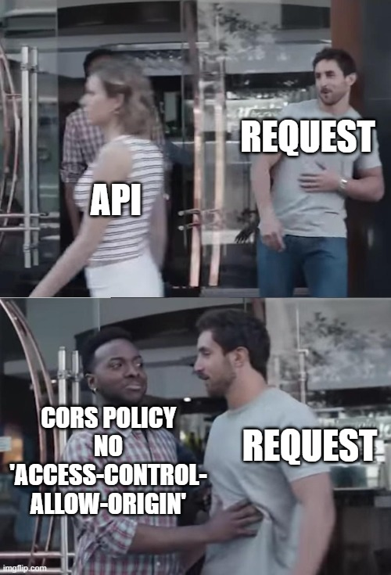
Typical Data Traversal
Web Application
Web API
Requests
Response
Data
Database
Notes:
Cross-Origin Resource Sharing (CORS) is a mechanism that uses additional HTTP headers to tell browsers to give a web application running at one origin, access to selected resources from a different origin.
If encountered, server must be adjusted. Not the client

Slide 20
Typical Web API calls
Web API
GET URL
Component A
Component B
Component C
Notes:
It’s not unusual to have a use case where 3 components need to access the same API call.
For such scenarios, we usually create a reusable code. Say for example, we get our items from the API

Slide 21
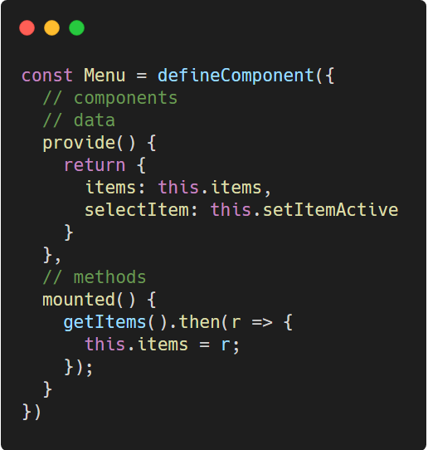
Provide + Inject: Problem
Provide and inject is NOT reactive.
Such promises won’t reflect in the injection
Notes:
The problem with provide and inject is that they are not reactive. That is with Options API. In this case, MenuItem won’t get the updated value of items. What you can do instead is do the long way round of passing the data via props which is a hassle
Code: https://carbon.now.sh/?bg=rgba%28255%2C255%2C255%2C1%29&t=vscode&wt=none&l=javascript&ds=false&dsyoff=20px&dsblur=68px&wc=true&wa=true&pv=56px&ph=56px&ln=false&fl=1&fm=Hack&fs=14px&lh=133%25&si=false&es=2x&wm=false&code=const%2520Menu%2520%253D%2520defineComponent%28%257B%250A%2520%2520%252F%252F%2520components%250A%2520%2520%252F%252F%2520data%250A%2520%2520provide%28%29%2520%257B%250A%2520%2520%2520%2520return%2520%257B%250A%2520%2520%2520%2520%2520%2520items%253A%2520this.items%252C%250A%2520%2520%2520%2520%2520%2520selectItem%253A%2520this.setItemActive%250A%2520%2520%2520%2520%257D%250A%2520%2520%257D%252C%250A%2520%2520%252F%252F%2520methods%250A%2520%2520mounted%28%29%2520%257B%250A%2520%2520%2520%2520getItems%28%29.then%28r%2520%253D%253E%2520%257B%250A%2520%2520%2520%2520%2520%2520this.items%2520%253D%2520r%253B%250A%2520%2520%2520%2520%257D%29%253B%250A%2520%2520%257D%250A%257D%29

Slide 22
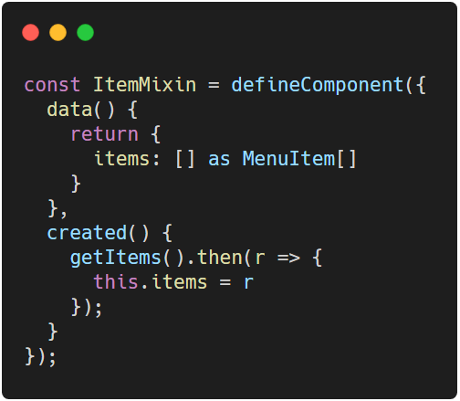
Introducing Mixins
A mixin object can contain any component options that mixes in w/ another Vue instance
Notes:
Mixin is basically another Vue instance that doesn’t have a template. Its core functionality is to share codes. Mixins do not have templates. Their extension could just be plain typescript extension
State inside a mixin is NOT shared
TypeScript: https://carbon.now.sh/?bg=rgba%28255%2C255%2C255%2C1%29&t=vscode&wt=none&l=javascript&ds=false&dsyoff=20px&dsblur=68px&wc=true&wa=true&pv=56px&ph=56px&ln=false&fl=1&fm=Hack&fs=14px&lh=133%25&si=false&es=2x&wm=false&code=const%2520ItemMixin%2520%253D%2520defineComponent%28%257B%250A%2520%2520data%28%29%2520%257B%250A%2520%2520%2520%2520return%2520%257B%250A%2520%2520%2520%2520%2520%2520items%253A%2520%255B%255D%2520as%2520MenuItem%255B%255D%250A%2520%2520%2520%2520%257D%250A%2520%2520%257D%252C%250A%2520%2520created%28%29%2520%257B%250A%2520%2520%2520%2520getItems%28%29.then%28r%2520%253D%253E%2520%257B%250A%2520%2520%2520%2520%2520%2520this.items%2520%253D%2520r%250A%2520%2520%2520%2520%257D%29%253B%250A%2520%2520%257D%250A%257D%29%253B

Slide 23
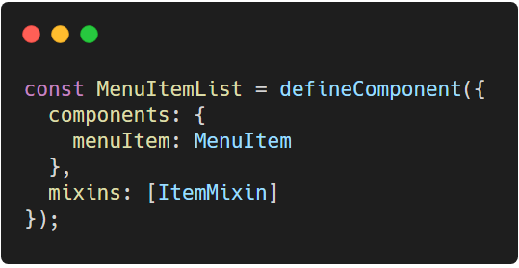
Using mixins
Components can the use the mixin via mixins options.
You can have multiple mixins
Notes:
One redeemable problem with mixins, you have to make it so that it is type safe.
TypeScript: https://carbon.now.sh/?bg=rgba%28255%2C255%2C255%2C1%29&t=vscode&wt=none&l=javascript&ds=false&dsyoff=20px&dsblur=68px&wc=true&wa=true&pv=56px&ph=56px&ln=false&fl=1&fm=Hack&fs=14px&lh=133%25&si=false&es=2x&wm=false&code=const%2520MenuItemList%2520%253D%2520defineComponent%28%257B%250A%2520%2520components%253A%2520%257B%250A%2520%2520%2520%2520menuItem%253A%2520MenuItem%250A%2520%2520%257D%252C%250A%2520%2520mixins%253A%2520%255BItemMixin%255D%250A%257D%29%253B

Slide 24
Thank You
Up Next . . . Composition API

